Slide 1

Project Work – II (Out-house)
Session: Jan-May 2022
Submitted By: Sarthak Kale (EN18CS301232)
Coordinator: Mr. Sachin Solanki
Submitted To: Ms. Swati Tahiliani

Slide 2
Introduction
ParallelDots is a start-up from Gurugram, India which was incorporated on 22 November 2022. ParallelDots’ Shelfwatch analyses images of retail shelf display and supplies corrective feedback that helps CPG & Retail brands supercharge their retail execution. It can be considered as a software that uses image recognition for Perfect Retail Execution and Performance Indicators Calculation. The major clients of ParallelDots include ITC, SPAR Cooperation, Mondelez Internation, Uniliver, etc. The major technologies are Python3.5, MySQL, NodeJS, ReactJS, Android, HTML, etc. The company includes about 70+ employees.

Slide 3
Internship Details
Internship: Back-end Developer at PARALLELDOTS TECHNOLOGY PRIVATE LIMITED
Type: Company-based Internship
Mentor: Yash Prajapati (HR Manager)
Duration: January – June 2022
Designation: Backend Software Developer

Slide 4
Company Documents
MCA Proof: EN18CS301232_MCA_PDF
CIN Number: U74999DL2017FTC326231
Offer Letter Proof: EN18CS301232_OfferLetter_PDF
Ten Crore Proof: EN18CS301232_TenCr_PDF
Internship Certificate: EN18CS301232_Internship_Certificate_PDF

Slide 5
Marketing Terminologies
Stock Management Stock management commonly known as inventory management is the function of understanding the stock mix of a company and the different demands on that stock. The demands are influenced by both external and internal factors and are balanced by the creation of purchase order requests to keep supplies at a reasonable or prescribed level. Inventory management is important for every other business enterprise. Stock management refers to the process of ordering, storing, using, and selling a company's inventory. This includes the management of raw materials, components, and finished products, as well as warehousing and processing of such items.
Planogram Planograms, also known as Plano-grams, plan-o-grams, schematics and POGs, are visual representations of a store's products or services on display. They are considered a tool for visual merchandising. A planogram is a diagram that shows how and where specific retail products should be placed on retail shelves or displays to increase customer purchases. A planogram is a schematic tool retailers use to plan their store layout to maximize sales and customer experience. Planograms place special attention on product placement and displays as well as point-of-sale (POS) location(s).
SKU In the field of inventory management, a stock keeping unit (SKU) is a distinct type of item for sale, bought, or tracked in inventory, such as a product or service, and all attributes associated with the item type that distinguish it from other item types. A stock-keeping unit (SKU) is a scannable bar code, most often seen printed on product labels in a retail store. The label allows vendors to automatically track the movement of inventory. The SKU is composed of an alphanumeric combination of eight-or-so characters.
Shelf A Shelf can be shown as a single row in a planogram, which can hold a specific collection of SKU or object.

Slide 6
Marketing Terminologies
Self-Product A self-product is an SKU which is developed by the client. All the SKUs which are being produced by the client are considered as Self-Products.
Competitor-Product A competitor-product is an SKU which is not developed by the client but is of same category and both kind of SKUs are present in the same planogram. All the SKUs not produced by client which are present on the common planogram are considered as Competitor-Products.
KPI A performance indicator or key performance indicator (KPI) is a type of performance measurement. KPIs evaluate the success of an organization or of a particular activity in which it engages. KPI stands for key performance indicator, a quantifiable measure of performance over time for a specific goal. KPIs supply targets for teams to shoot for, milestones to gauge progress, and insights that help people across the organization make better decisions. Often success is simply the repeated, periodic achievement of some levels of operational goal and sometimes success is defined in terms of making progress toward strategic goals. Accordingly, choosing the right KPIs relies upon a good understanding of what is important to the organization. What is considered important often depends on the department measuring the performance – e.g., the KPIs useful to finance will differ from the KPIs assigned to sales.

Slide 7
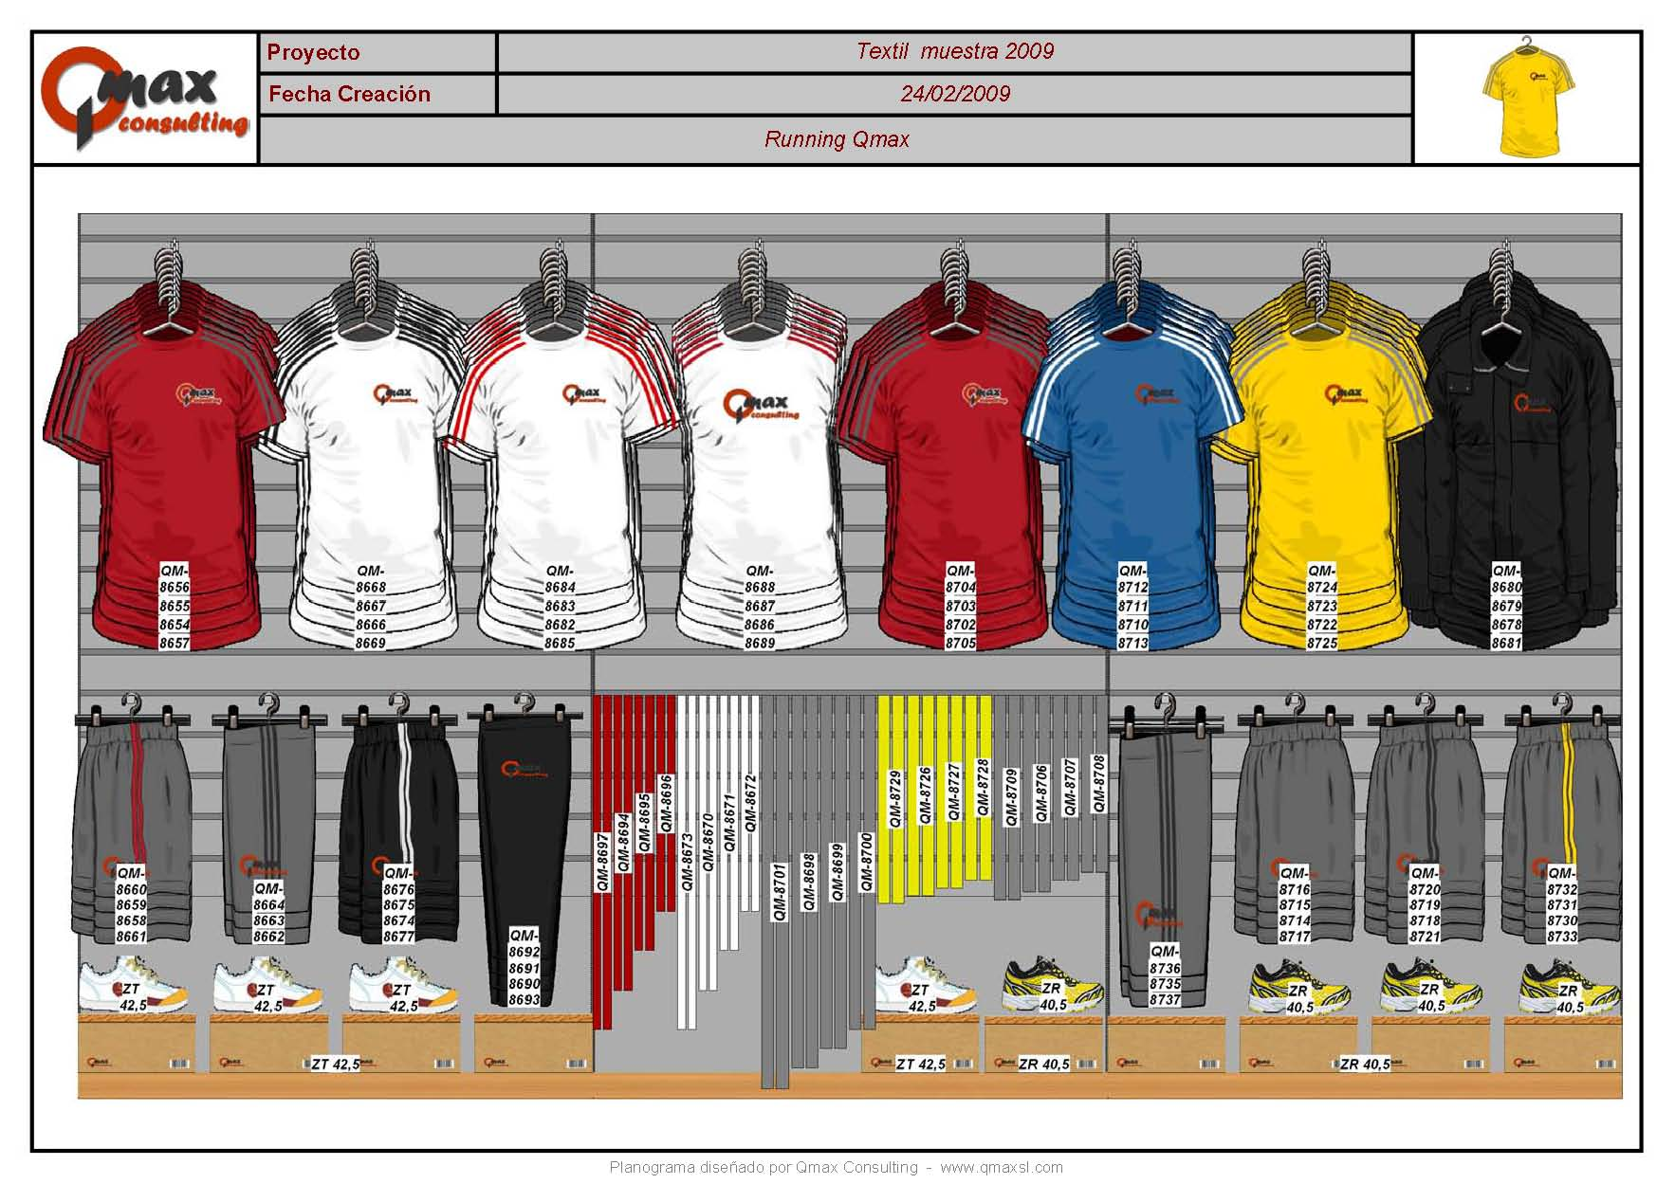
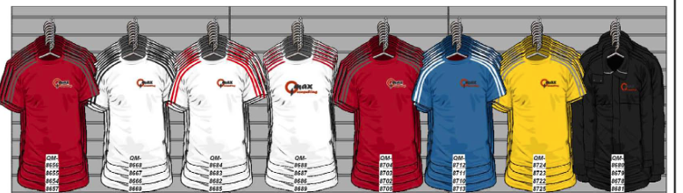
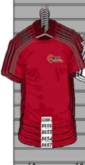
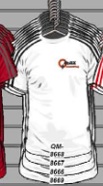

Planogram ->
Shelf ->
SKUs ->

Slide 8
Company Work Profile
In this company, I am working as a Backend Software Developer.
The primary technologies that I have been working on include Python and MySQL. Also, I have hands-on experience on Git, Django, Flask Framework and AWS Cloud services.
The clients capture and upload images on the ShelfWatch android application. These images are then uploaded on AWS S3 bucket. These images are passed through a process of image-recognition and object-tagging by data-scientists and taggers. These tagged images’ data gets uploaded in S3 bucket. This data is fetched and is used to calculate the set of KPIs which were specified by client and is returned as table data for individual client-output-sheet in the bucket. These tables are then further used to display the generated KPIs on front-end with 2 different displays i.e., Dashboard and Gallery in the Android application for client-specific users.
This is the entire working cycle of ShelfWatch application for a particular client.

Slide 9
Brief about Python
Python was developed by Guido van Rossum and was released in 1991.
A scripting language is one that is interpreted. Python is an interpreted language. Python uses an interpreter to translate and run its code. Hence Python is a scripting language.
Python is a high-level, general-purpose programming language. Its design philosophy emphasizes code readability with the use of significant indentation. Its language constructs and object-oriented approach aim to help programmers write clear, logical code for small- and large-scale projects.
Pandas is a software library written for the Python programming language for data manipulation and analysis. In particular, it offers data structures and operations for manipulating numerical tables and time series. It is free software released under the three-clause BSD license.

Slide 10
Brief about MySQL and CSV
MySQL was developed by Michael Widenius and was released in 1995.
MySQL is an open-source relational database management system. Its name is a combination of "My", the name of co-founder Michael Widenius's daughter, and "SQL", the abbreviation for Structured Query Language.
The application is used for a wide range of purposes, including data warehousing, e-commerce, and logging applications. The most common use for MySQL, however, is for the purpose of a web database.
SQL is a query programming language that manages RDBMS. MySQL is a relational database management system that uses SQL. SQL is primarily used to query and operate database systems. MySQL allows you to handle, store, modify and delete data and store data in an organized way.
CSV A comma-separated values file is a delimited text file that uses a comma to separate values. Each line of the file is a data record. Each record consists of one or more fields, separated by commas. The use of the comma as a field separator is the source of the name for this file format.

Slide 11
My Tasks as Developer
In this internship, as explained in the above process, my primary tasks include:
Uploading the images from application to S3 bucket.
Calculation of KPI which are specific to a client’s requirements.
Creating output-dump sheet and uploading it to S3 bucket.
Creating daily tagging status report.
Created a script to daily sent the tagging-report to a group of people from business team so that they can do quality-check on tagging-report as well as client-output-sheet.
Updating analytics and functionalities of existing projects according to client's requirements.
Optimising and debugging the daily-tagging-report, dashboard and gallery analytics.

Slide 12
Project and Proposed Method
In this subject Project Work – II, I will be giving a demo project which is a Python3 Script.
I will use an actual client project that I have created for Haribo-KC and will include
requested KPI set.
In this real project, I had to follow the following steps:
1. Upload images from application to AWS S3 bucket. (optional)
2. Fetch tagged-images' data from AWS S3 bucket and arrange that into a usable
format.
3. Using this format, calculate the client-specific KPIs and generate a client-output sheet.
4. Upload this client-output sheet to the S3 bucket in client’s folder(optional)
5. Also generate a set of sheets which are collectively called as qc-sheets. These qc-
sheets are used for quality-check of generated output by business team members.
6. Send this qc-sheet set along with client-output sheet to the business team, a Python3
script is created to mail the data.
7. Generate ticket on Jira to setup a cron-task for daily execution of scripts once
finalised.

Slide 13
PW-II Project Submission
In PW2 project submission, I will submit a ZIP file which will include following:
1. An input sheet for an entire date’s tagging data (input_data.csv)
2. An output sheet which holds result with data and columns according to client’s
requirements (result_df.csv)
3. A set of other CVSs which are generated along with output-sheet in the script and are needed for quality-check.
4. KPI requested by client is to weigh SKUs based on their space requirements. Then to find a variety of ratios based on Shelf-data for Shelf and Competitor SKUs.
ZIP file Link : EN18CS301232_PW2_Project_Code

Slide 14

Thank You

